Slide 1

MakeMyTrip Test Case Automation
By: Harsh Vashishth

Slide 2
Test Case Overview
This test case focuses on verifying the functionality of selecting a departure city and an arrival city, then accurately displaying the cheapest available flight within the next 15 days.

Slide 3

Tools & Technologies
This project leverages a robust stack of core technologies to ensure efficient and reliable test case automation.
Selenium
Cucumber
An open-source framework used for automating web browser interactions and validating web applications.
A BDD (Behavior-Driven Development) tool that allows defining application behavior in plain English using Gherkin syntax.
Maven
Java
A powerful project management and comprehension tool that handles project builds, reporting, and documentation.
The primary programming language used for developing the test automation framework and scripts.

Slide 4
Implementation Details
This project showcased several key achievements in its implementation, focusing on best practices for test automation.
Proper Naming Conventions
Implemented Logger using Log4j
Ensuring code readability and maintainability across the project.
For comprehensive logging of test execution steps, debugging information, and error tracking throughout the automation framework.
Allure Reports
No Hardcoded Values
Featuring screenshots on success for better test visibility and documentation.
Promoting flexibility and ease of configuration for various environments.
Used data.properties
Excel Values Reading
Externalizing test data and configurations for better management.
Implemented functionality to read test data directly from Excel files, enabling dynamic test case execution with multiple data sets.
Base Class Implementation
Exception Handling
Providing a foundational structure for common functionalities and reusability.
Ensuring graceful error management and application stability during test execution.
Page Object Model (POM)
Implemented for cleaner code and reducing duplicacy, enhancing maintainability.

Slide 5
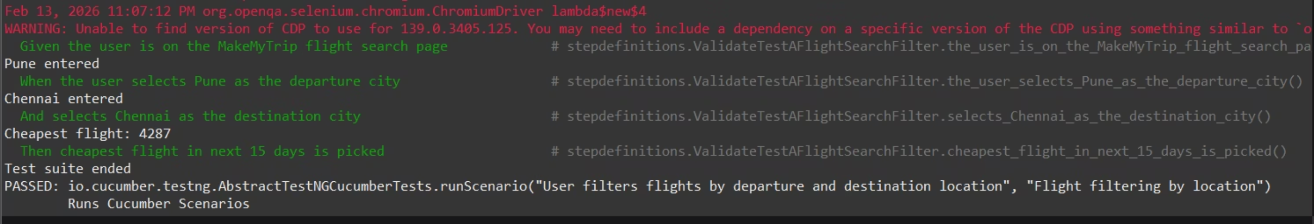
Output Screenshots - Test Execution Results
Complete execution steps with logs in console.

Slide 6
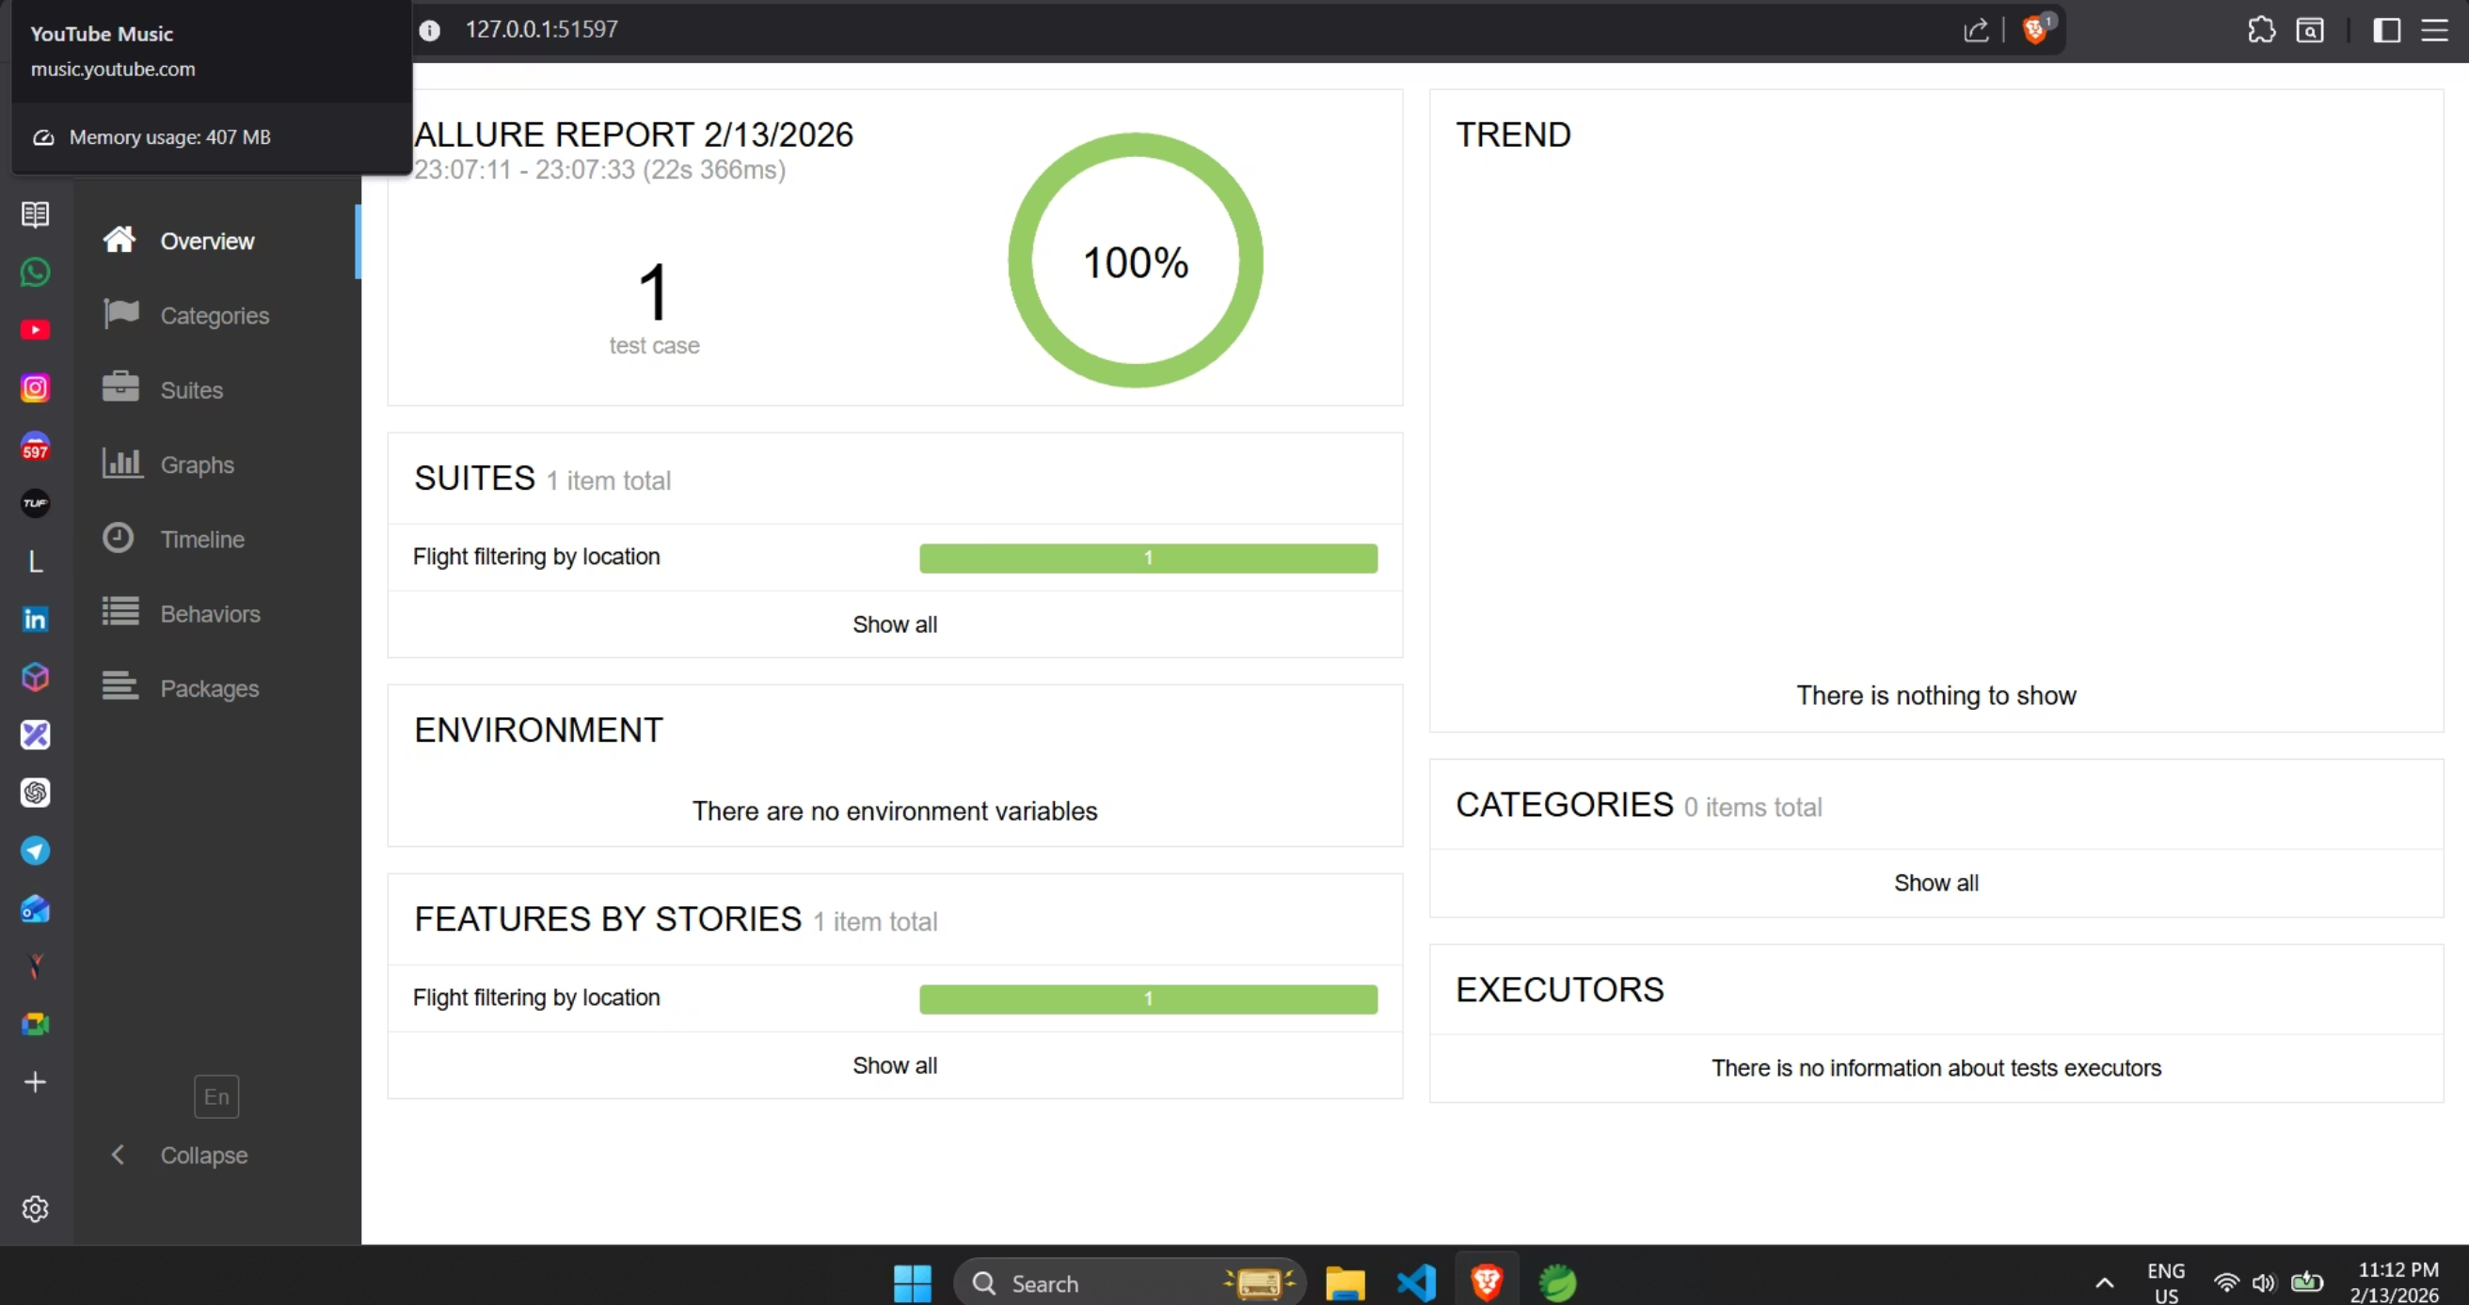
Output Screenshots - Allure Report Generation
Allure report dashboard displaying comprehensive test execution metrics, detailed logs, and visual representation of test results.

Slide 7
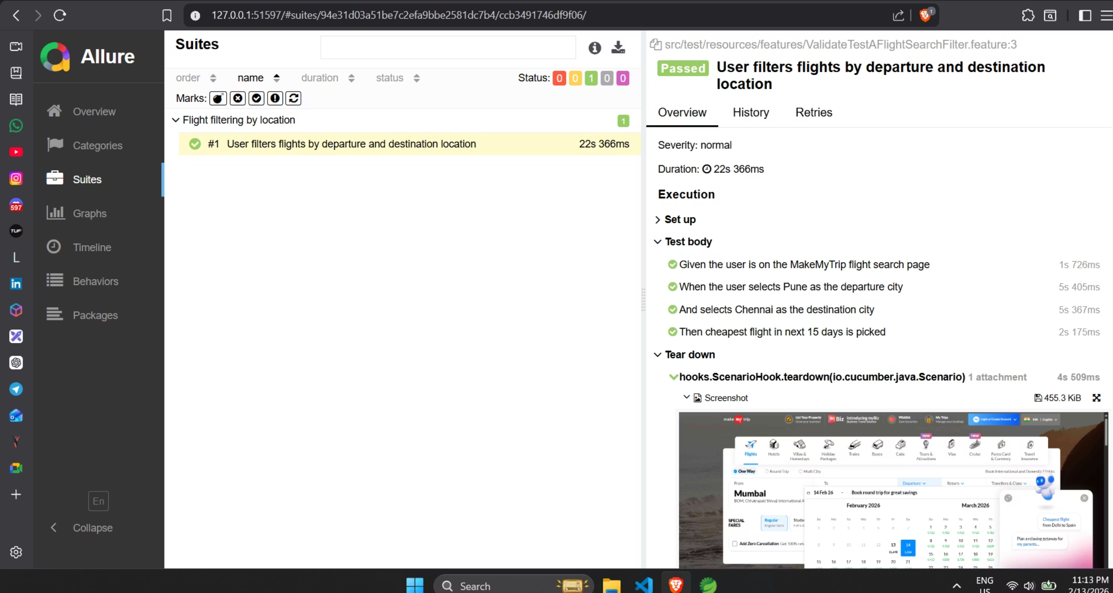
Output Screenshots - Detailed Report
In-depth report of test suite with each test case timing, total duration, and screenshots capturing the complete test execution lifecycle.

Slide 8
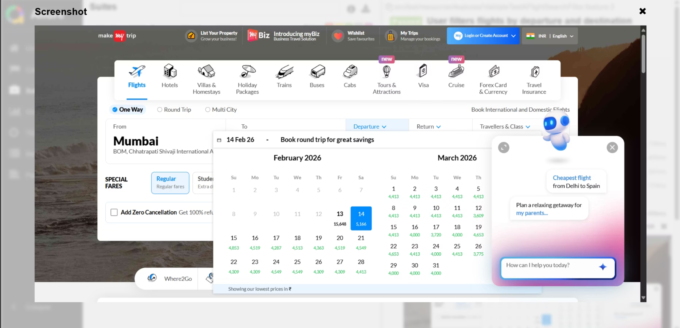
Output Screenshots - Cheapest Flight's Price Result
MakeMyTrip website displaying the cheapest flight option identified within the 15-day search window, showcasing the successful automation of the flight selection process.

Slide 9

Key Learnings
01
02
Direct String Passing
Conditional Assertions
We can pass strings in feature file directly.
Assertions can be used with conditions eg Assert.assertTrue(routes.size() > 0,"No flight results found!").
03
04
Visibility over Clickability
Save Before Checking
Try using visibility of instead of elementToBeClickable to avoid element click intercepted exception.
Always save the file before checking any errors in your code :).

Slide 10

Thank You
Thank you for your attention! Any Questions?

